Slide 1
SCENARIO W: EMG SENSOR WITH AUDIOVISUAL OUTPUT
Group 9
Franky Saxena
Bruno Calogero
Daniel Saul
Theo Velon
Notes:
Our task was to process the EMG signals from our muscles to produce some sort of an output. We chose this output to be an audiovisual in the form of a MIDI instrument on Garageband with the intensity of the voltage produced by flexing the muscle changes the pitch of the sound, and also separately where an LED that lights up. A few problems that we faced were that the voltage picked up by muscles is very low to be able to translate accurately into the Arduino, so we need to amplify that, and also some unwanted signal from the surroundings which we need to filter out. Then all of this is digitally processed using a rectifier and integrator so the signal is smoothly fed into the Arduino.
Now we will talk about our overall system design.

Slide 2
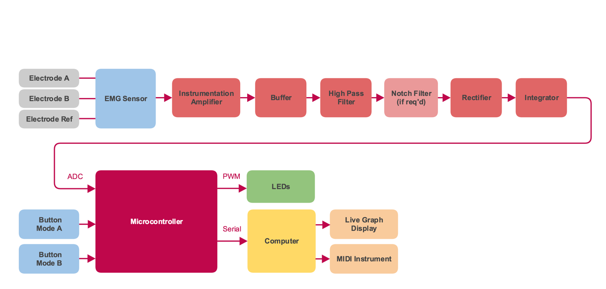
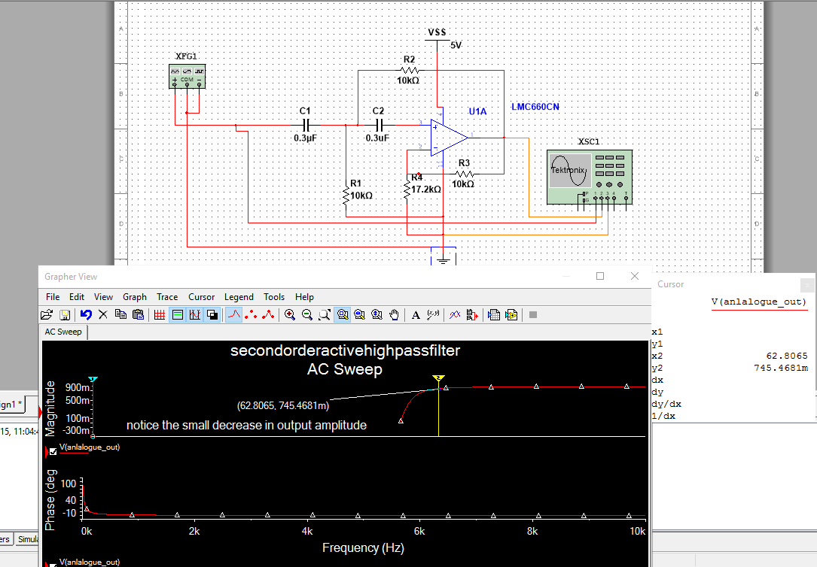
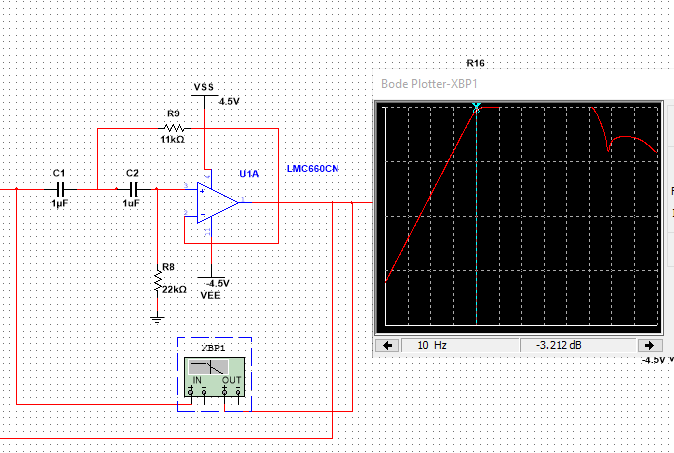
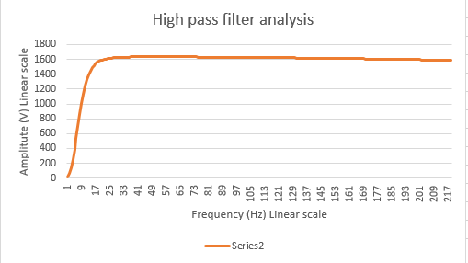
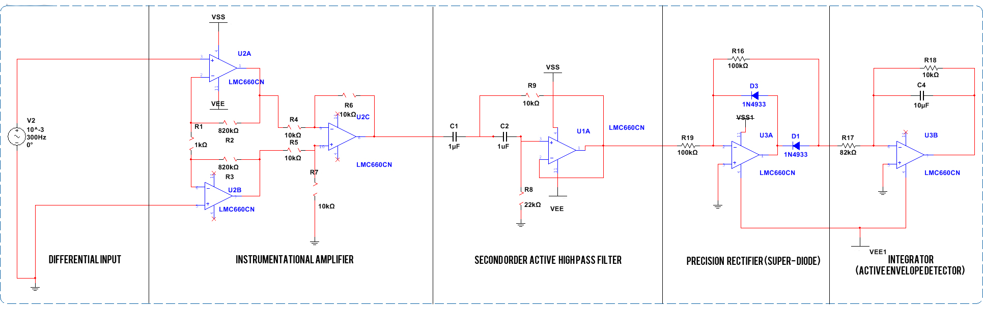
OUR SOLUTION
Figure 2 Multisim schematic
Figure 1 Overall subsystem
Figure 4 High pass filter response
Figure 5 High Pass Bode Plot
Figure 3 Bode plot response
Notes:
This is the overall subsystem of the problem in hand. We grouped these subtasks into subsystems such as the IA with the HPF, Rec with Int, ADC with Microcontroller.

Slide 4
OUTPUTS

Slide 5
ISSUES AND HOW WE RESOLVED THEM

